Slide 1







AISL OUTDOOR
WINTER CAMP
www.aisloutdoor.com
info@aisloutdoor.com

Slide 2
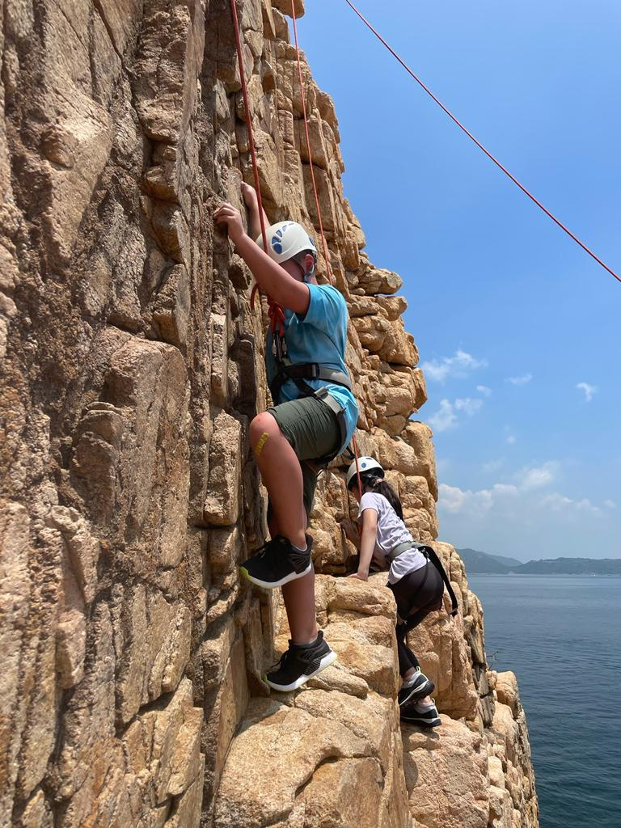
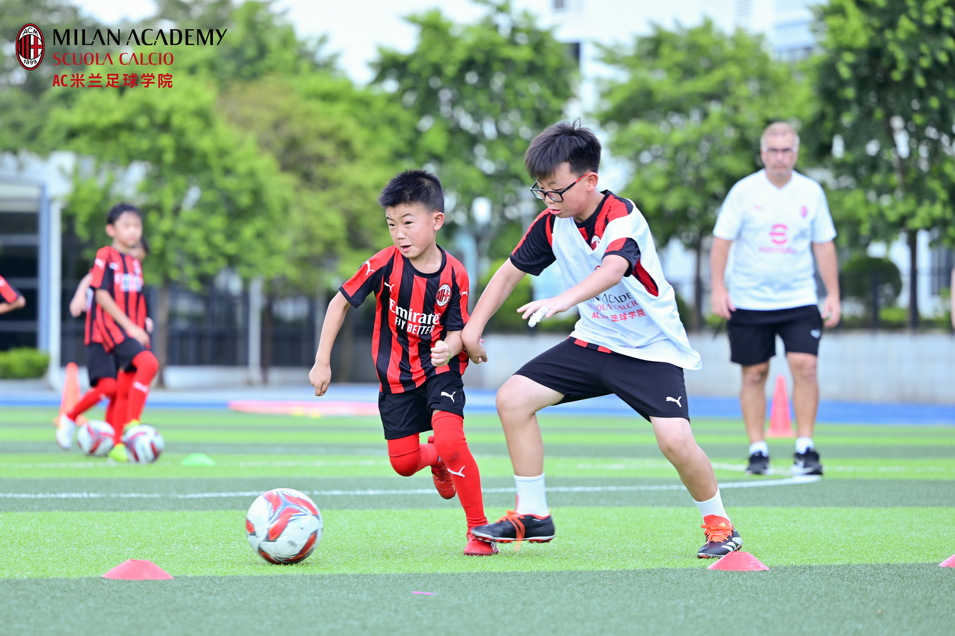









OVERVIEW
16 Dec 2024 - 25 Jan 2025
3-18 years old
AISL Harrow Appi; AISL Harrow Hong Kong; AISL Harrow Shenzhen
Over 10 captivating programmes spanning 6 dynamic categories:
Adventures
Arts
Communications
Sports
STEM
Early Explorers

Slide 3



OUR PROGRAMMES
Adventures
Arts
(3 years old and above)
(8-18 years old)
Experience the thrill of gliding across the pristine slopes at the award-winning Appi Kogen Ski Resort, coupled with the world-class residential school experience of AISL Harrow Appi.
Dive into the ancient art of Chinese Ink, revel in the elegance of traditional Qipao making, or awaken culinary talents at Little Chefs.
Communications
Sports
(8-13 years old)
(8-12 years old)
Enhance English fluency through public speaking, debating, and creative expression, or empower entrepreneurial spirits in the Future Founders 2 Programme.
Experience the AC Milan Football Camp, an intensive programme blending skill enhancement with legendary football techniques.
STEM
Early Explorers
(8-12 years old)
(3-5 years old)
Advance coding skills in our Game Development 102 Camp or join our Mobile Game Developer Camp to create unique games using HTML, CSS, and JavaScript.
Unleash children's imagination at the Ballroom Dance camp, blending dance styles and themes to boost creativity and coordination.

